Slide 1

The National University of Computer and Emerging Sciences
Repetition structures
CS 1002 Programming Fundamentals
Dr. Akhtar Jamil
Department of Computer Science

Slide 2
Goals
Review Of Previous Lecture
Repetition structures
While
Do – While
For
Nesting

Slide 3
Previous Lecture

Slide 4
Today’s Lecture

Slide 5
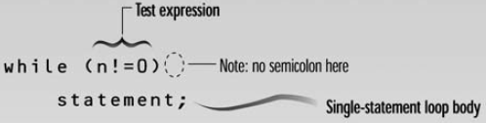
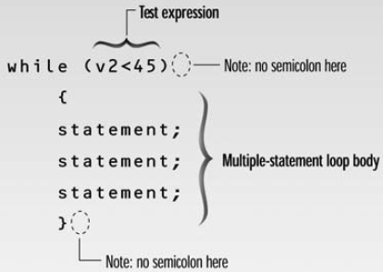
while loop - syntax
Loop body contain
single statement
Loop body contain
Multiple statement

Slide 6
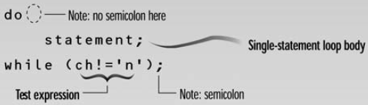
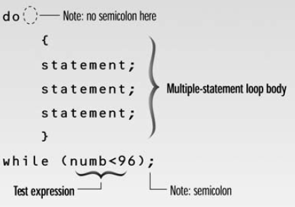
do while loop - Syntax
Loop body contain
single statement
Loop body contain
Multiple statement

Slide 7
break Statement
break statement
Immediate exit from while, for, do/while, (also used in switch)
break immediately ends the loop that contains it.
Common uses:
Escape early from a loop
Skip remainder part of the loop and exit

Slide 8
break Statement - Examples
for (int i=1; i<=5; i++)
{
if (i==3)
break;
cout<<“Hello”;
}
int n;
int EvenSum=0;
while(1)
{
cin>>n;
if(n%2==1)
break;
EvenSum = EvenSum + n;
}

Slide 9
(using break in loops) – Class Exercise 1
Write a program which reads an integer n from the user, and prints square value (n*n) for that number. Whenever ZERO is entered by the user program should terminate by printing “Invalid Value” message.

Slide 10
continue Statement
continue statement
Only ends the current iteration
Skips remainder of loop body (in current iteration)
Proceeds with next iteration of loop
“continue” can only be inside loops (for, while, or do-while). IT CANNOT BE USED IN “switch”

Slide 11
continue Statement - Examples
for (int i=1; i<=5; i++)
{
if (i==3)
continue;
cout<<“Hello”<<i;
}
int n;
int EvenSum=0;
while(1)
{
cin>>n;
if(n%2==1)
continue;
EvenSum = EvenSum + n;
}

Slide 12
(Nested Loops) Nested Repetition Structures

Slide 13
(Nested Loops)
In a nested repetition structure, one loop (inner loop) is placed entirely within another loop (outer loop)
In nested loops any loop (for, while, or do loop) can be placed inside another loop which can be a for, while, or a do loop

Slide 14
(Nested Loops) - Examples
Outer Loop
for (int i=0; i<2; i++) {
for (int j=0; j<2;j++) {
cout<<“\nHello-”<<i<<“:“<<j;
}
}
Inner Loop

Slide 15
(Nested Loops) - Examples
int main()
{
int weeks=3, days_in_week=7;
for (int i = 1; i <= weeks; ++i) {
cout << "Week: " << i << endl;
for (int j = 1; j <= days_in_week; ++j) {
cout << " Day:" << j << endl;
}
}
return 0;
}

Slide 16
Programming Exercises
Write a program in C++ to display the first n terms of Fibonacci series.
Write a C++ program ask user to enter a positive number (N) and find the sum of first N natural numbers. If user enter N<=0, the program should display an error message.
Find the sum of digits of a given number entered by user.
Find the number of digits of a number entered by user.
Write a C++ program to take a number from user and check is it prime number or not.
Write a program in C++ to find the Greatest Common Divisor (GCD) of two numbers.

Slide 17
(Nested Loops) – Exercise-1
Write a program to print triangle of starts.
*
**
***
****
*****
******
*******
********
*********

Slide 18
(Nested Loops) – Exercise-2
Write a program to print triangle of starts.
*********
********
*******
******
*****
****
***
**
*

Slide 19
(Nested Loops) – Exercise-3
Write a program to print Rectangle based on two triangles (One using + and other using * symbol).
+********
++*******
+++******
++++*****
+++++****
++++++***
+++++++**
++++++++*
+++++++++

Slide 20
(for loop) -- Class Exercise-3
- Write a program that asks the user to enter two numbers (multiple of 10): speed1, and speed2 representing speeds in KPH (Kilo meters per Hour). Then the program should convert and show table of speeds in MPH (Miles per Hour) for all the speed values between speed1 and speed2.
MPH = KPH * 0.6214
speed1 and speed2 variables should be multiple of 10. Each table entry (in KPH) should be updated by 5 in each iteration.

Slide 21
Programming Exercises
Write a program in C++ to display the n terms of harmonic series and their sum. 1 + 1/2 + 1/3 + 1/4 + 1/5 ... 1/n terms
Write a program in C++ to Check Whether a Number can be Express as Sum of Two Prime.
Write a program in C++ to make such a pattern like a pyramid with numbers increased by 1
1
2 3
4 5 6
7 8 9 10

Slide 22
References
Credit goes to Dr. Muhammad Aleem for preparation of slides
Text book: Starting out with c++

Slide 23
Thank You ☺

